Slide 1
Calder IT
Local Nerds fixing stuff
Caldafax Products Ltd - Project tender

Slide 2
New office plan
Caldafax Products Ltd, a local company is expanding and requires new premises
3 owners
have been working from own homes but now have new corporate clients
Each is a specialist and will manage their own team
3 office admin staff / PA
30 specialist staff
10 Research and Development
10 Designer / Editors
10 Sales
The company wants all staff to have an office desk and to be able to work at client premises
Clients are expected to visit the premises for presentations

Slide 3
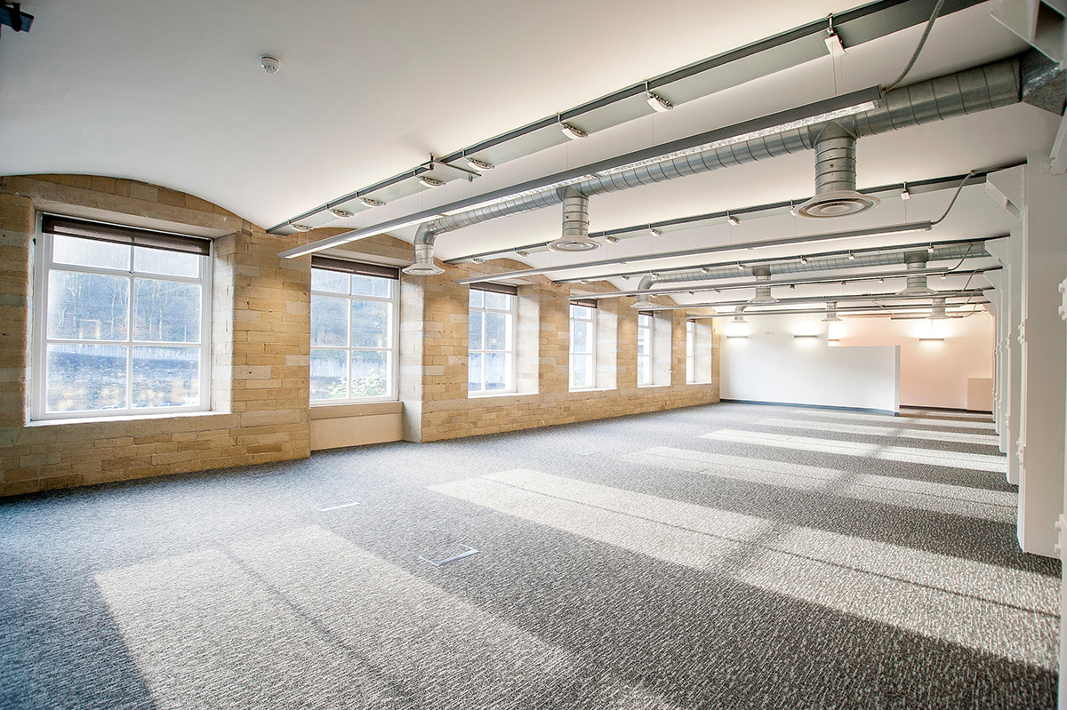
The new premises
Empty Mill floor
70m x 30m floor space
Central pillars every 10m
Large windows
Carpeted
Basic lighting and power are provided
Main door with 1 lock at end of room
Fire escape opposite end

Slide 4
Your task
Source all hardware and configure the premises
Including all office furniture
Computing equipment
Create all relevant compliance documents
They are currently interviewing new staff
They want to move in in 6 weeks
Budget is £100k
Estimate of ongoing costs

Slide 5
Your team
All are competent IT Technicians with additional skills/experience
Hourly rates reflect experience and responsibility
Your rate: £200 Per day
Jack Jomes – IP Telecoms / Cloud Engineer
£60 PH
Lenny Ovo – PC admin / Electrical Installation
£50 PH
Del Sisko- Network Administration/ Security
£65 PH
Lauren Ashley – Interior specialist / Graphic Design / Documentation
£55 PH

